Slide 1
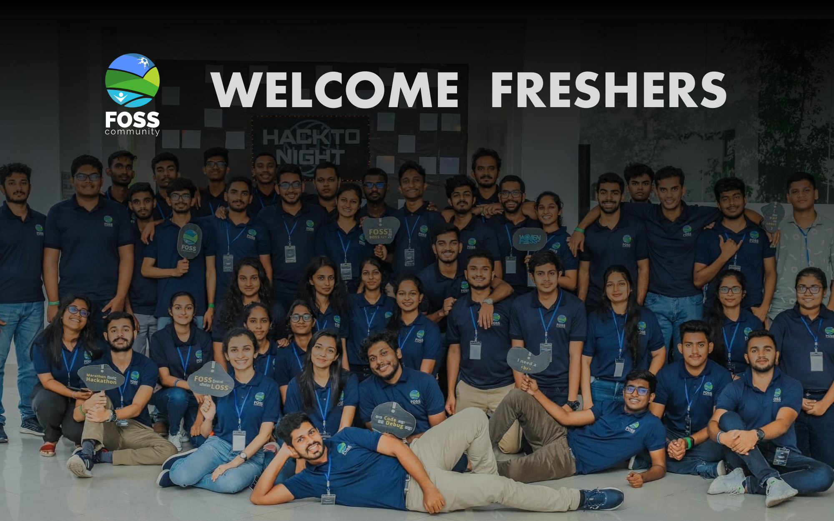

Slide 2
F
O
S
S
What is
FOSS ?

Slide 3
What is FOSS
Community
FOSS NSBM is a platform for NSBM students to organize themselves around the global Free and Open-Source Software movement.

Slide 4

History of the FOSS
Community NSBM

Slide 5
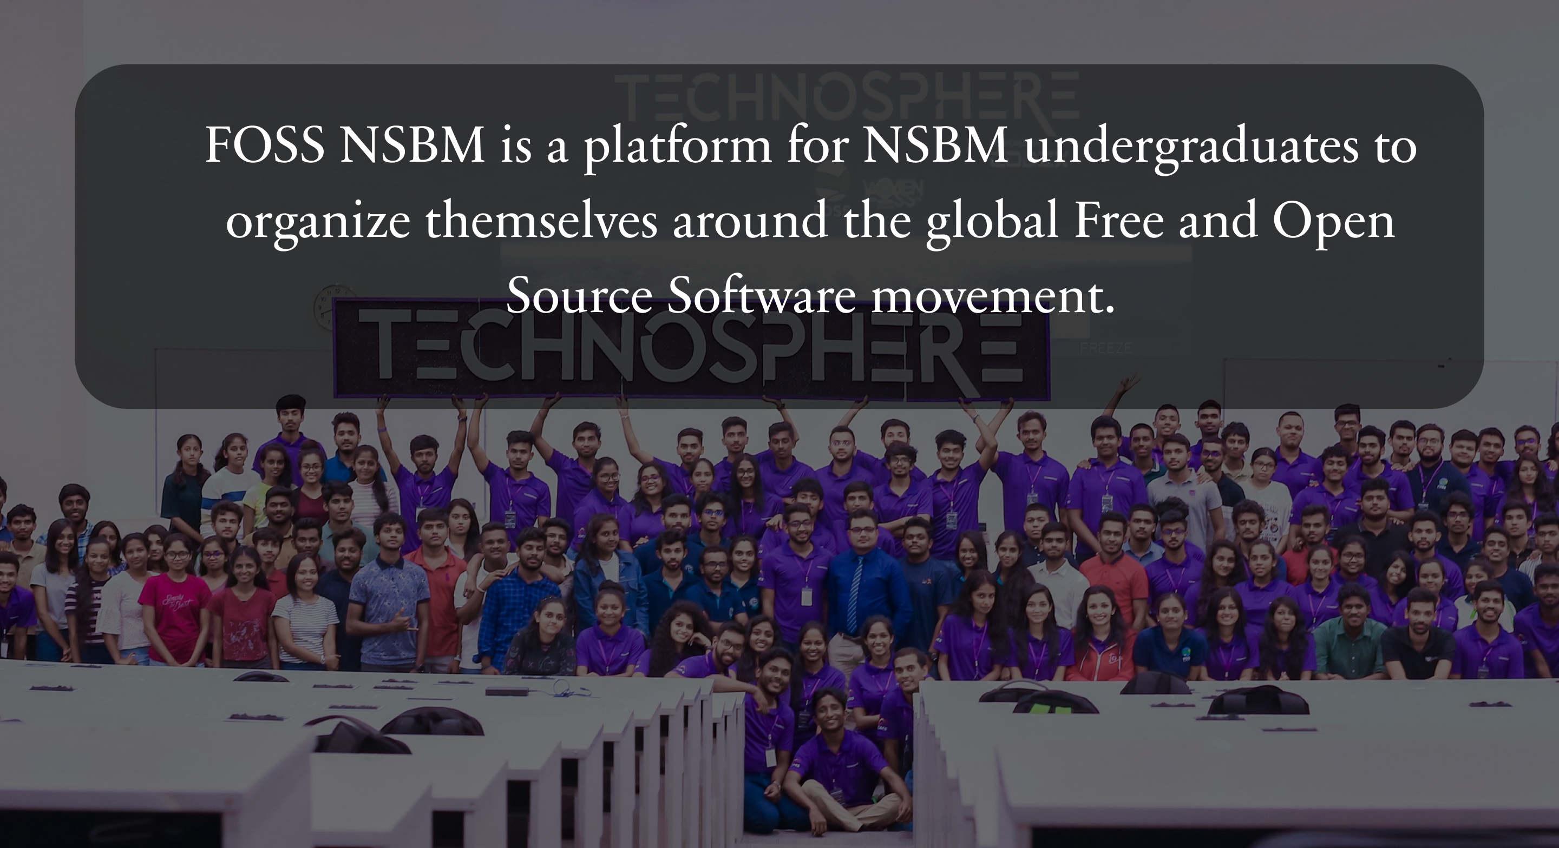

Slide 6
A community is a group of people with shared values, behaviors, and artifacts.
“
”
Free and Open Source

Slide 7
Joining of
Sub Community

Slide 8
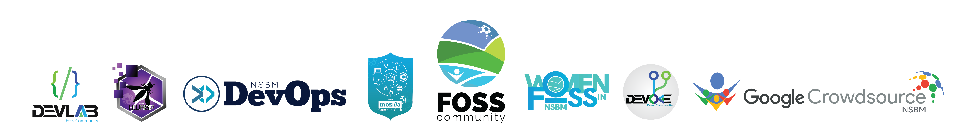
Mozilla Campus Club
The Mozilla Campus Club became the first subcommunity of FOSS NSBM. It was initiated in 2015 as the first Sri Lanka Mozilla camps club. Since then, for over 5 years Mozilla campus club ensures the community is up to date with the latest tech trends with its monthly meet-ups and other tech events.

Slide 9
DevOps
In a world where digitization and automation are major requirements to stand out from the crowd, the DevOps sub-community of FOSS NSBM plays a major role in organizing events to raise awareness of the latest DevOps practices.

Slide 10
DevLab
DevLab is a subcommunity of FOSS Community NSBM, a place where you get the chance to share and gain a vast knowledge of new technologies. A lot of events were held in collaboration with DevLab. Git & Github sessions, UI/UX and Scratch sessions are just a few out of the many sessions conducted by the DevLab sub-community.

Slide 11
Crowdsource
World’s first-ever Google CrowdSource Campus Club was Initiated by the NSBM FOSS Community. NSBM FOSS Community members got together and initialized a Google Crowdsource Campus Club and they were the ones to create the campus club logo too. This sub-community is dedicated to increasing the contribution of undergraduates to crowdsourcing for the benefit of all.

Slide 12
Devoke
Devoke which is another sub-community of FOSS Community NSBM was initiated as the Microsoft Campus Club in NSBM. This campus club was initiated on 22nd of April 2020 as an online Event. Among the events organized by the Devoke campus club, imagine cup and hacktoberfest take the main place. These events are international events and are held each and every year.

Slide 13

Women in FOSS
Originating first as WoMoz, Women in Mozilla, this women's community contributed greatly towards empowering women in technology. Later on, this campus club reformed in October 2020 as Women in FOSS to achieve targets even higher, benefiting both the female community and the FOSS NSBM too. WIF lends a hand to support all the females out there, to help them overcome their struggle when working in the tech industry.

Slide 14
Major milestones in the
history of FOSS NSBM

Slide 15
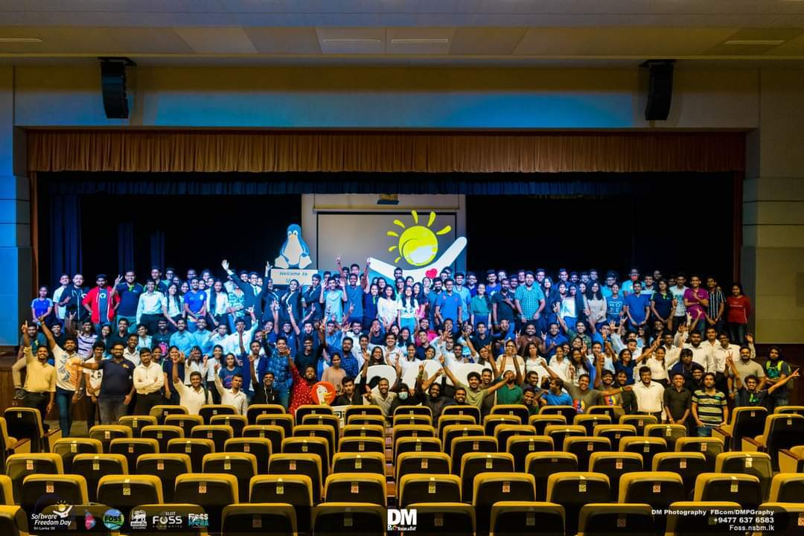
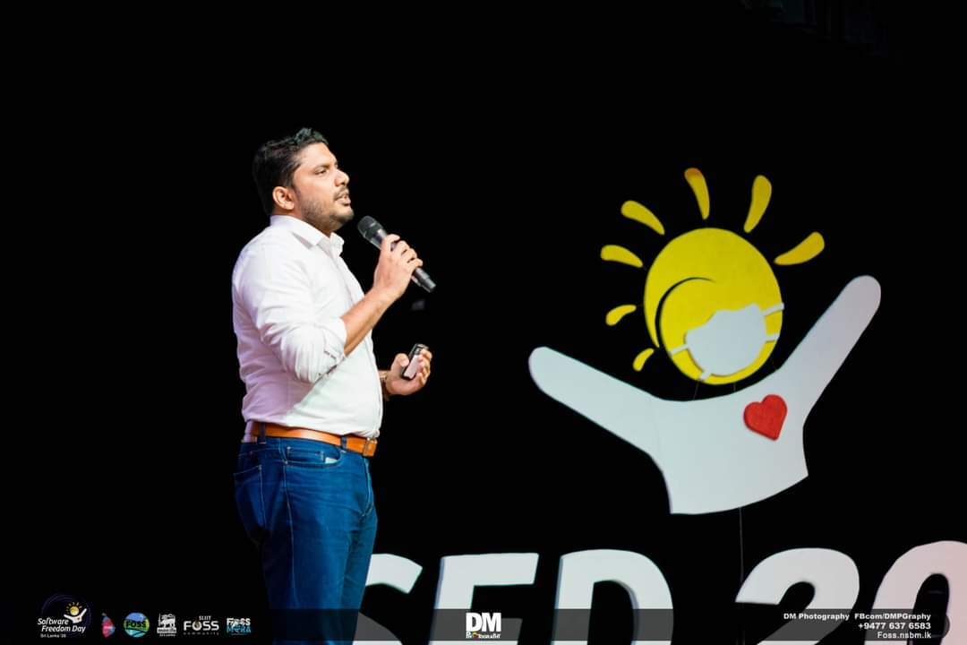
Software Freedom Day
2016, 2019, 2020
FOSS NSBM has organized the international Software Freedom Day celebrations on behalf of the Sri Lankan tech community three times since 2016.

Slide 16
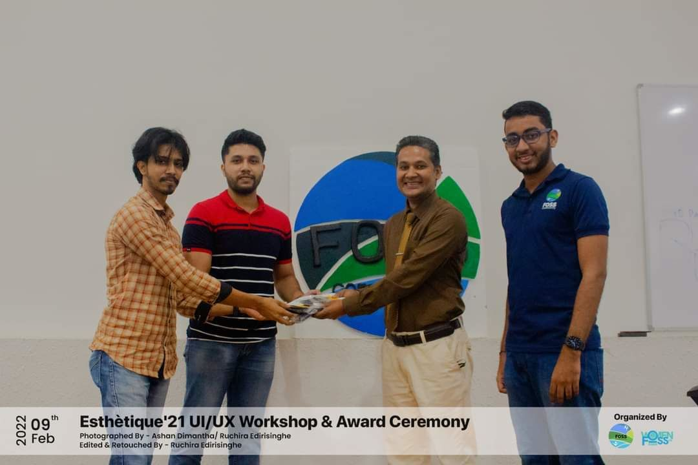
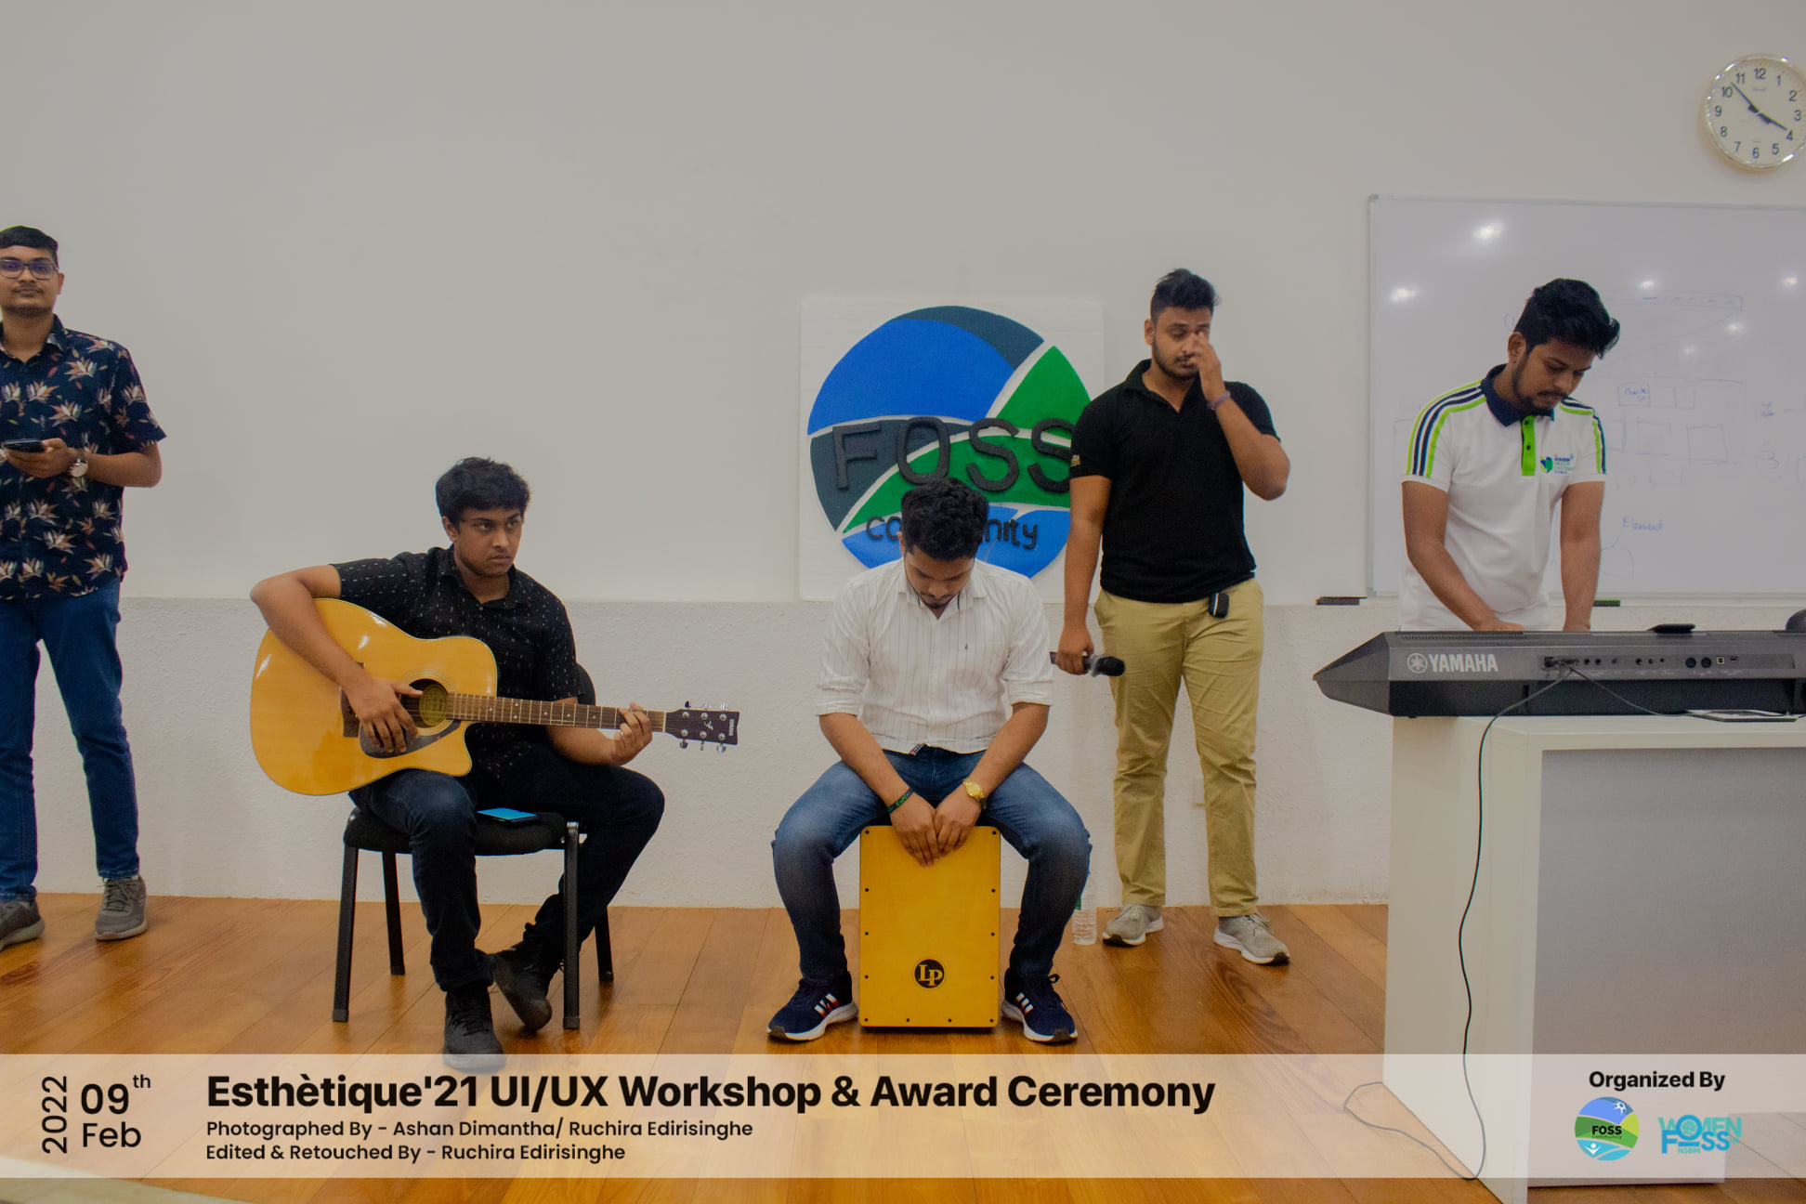
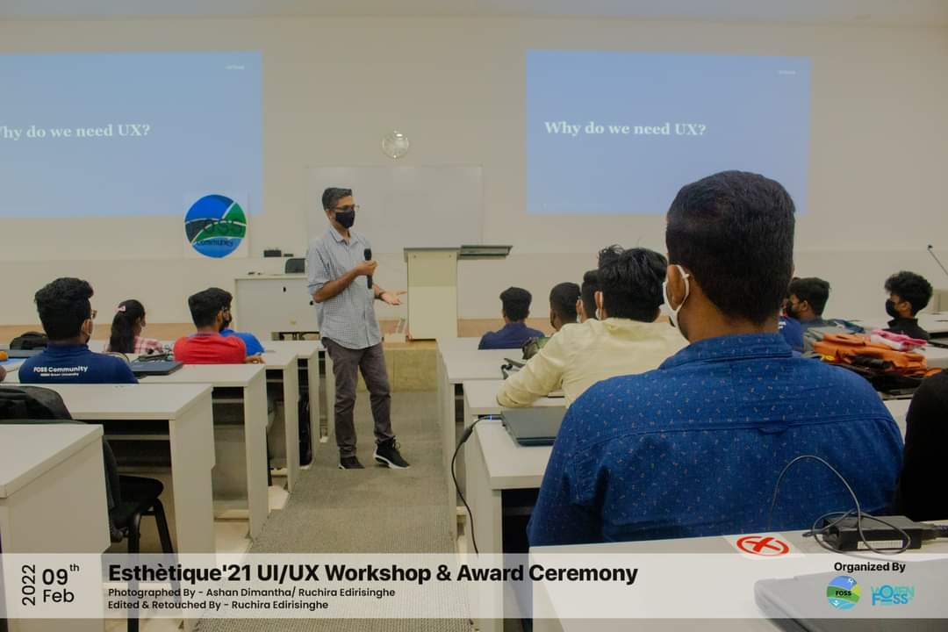
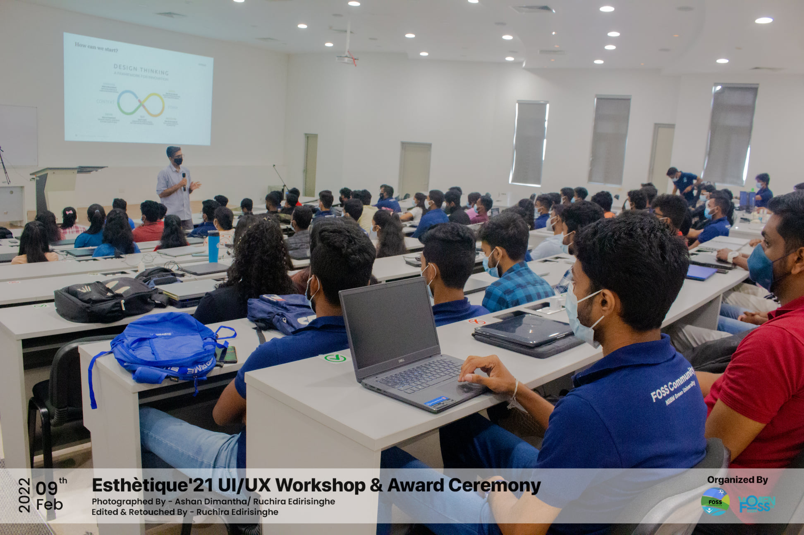
ESTHETIQUE ’21
UI/UX Workshop
“Esthétique ‘21” was a UI/UX hackathon organized by the FOSS Community of NSBM Green University, where a number of teams representing various schools and universities in Sri Lanka participated.

Slide 17
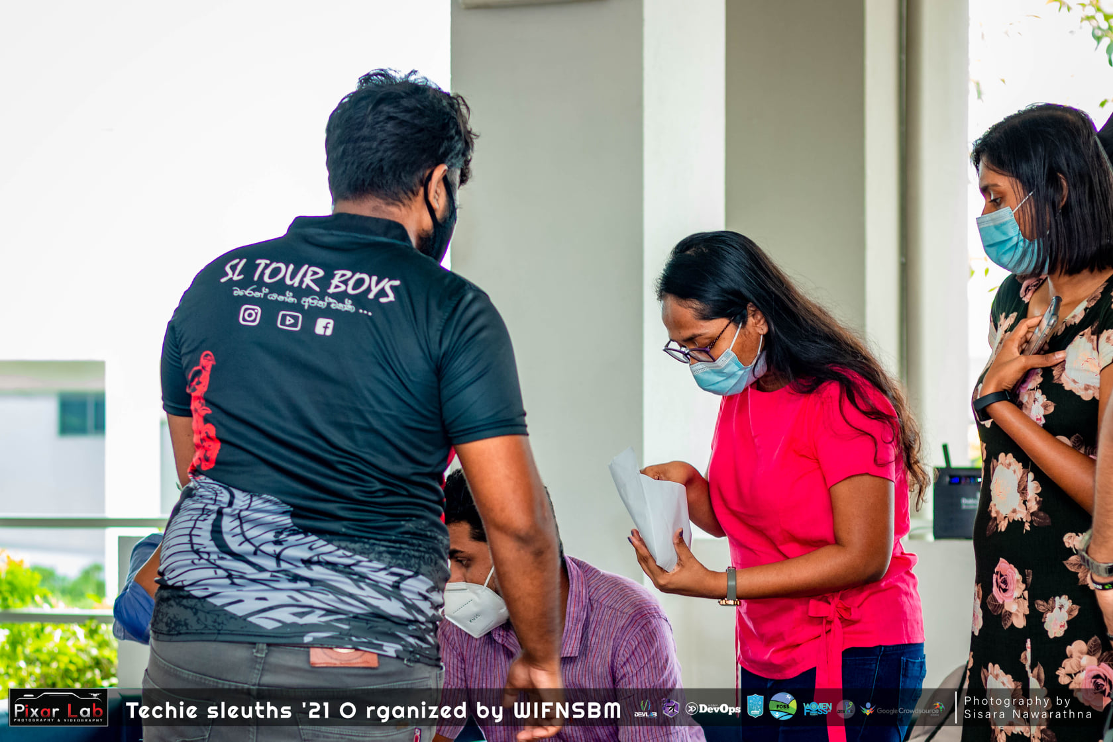
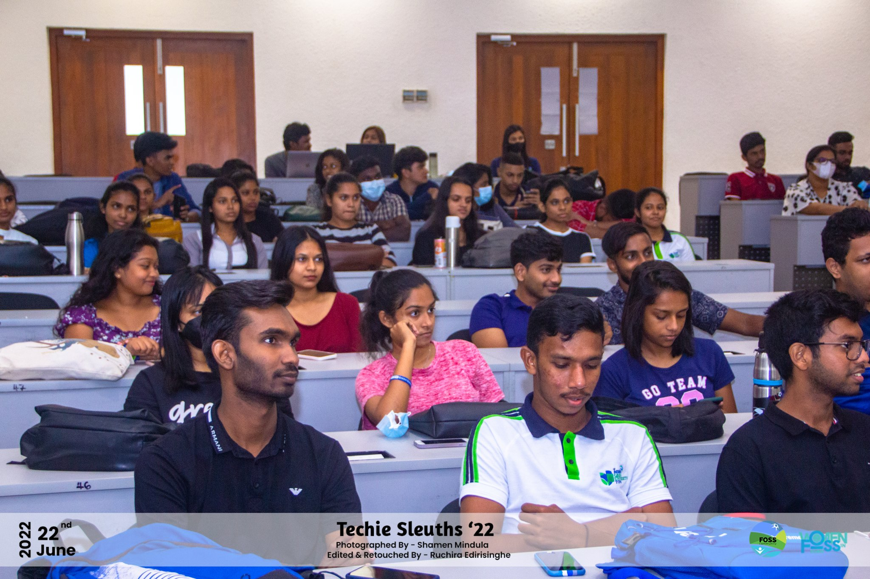
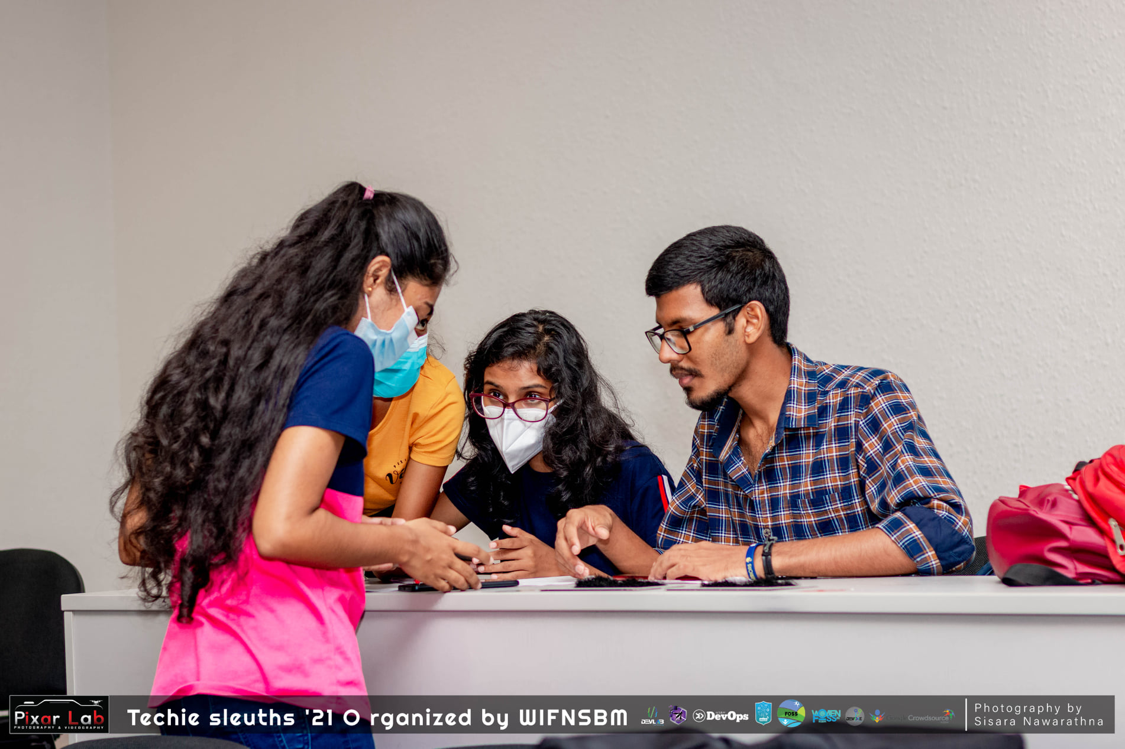
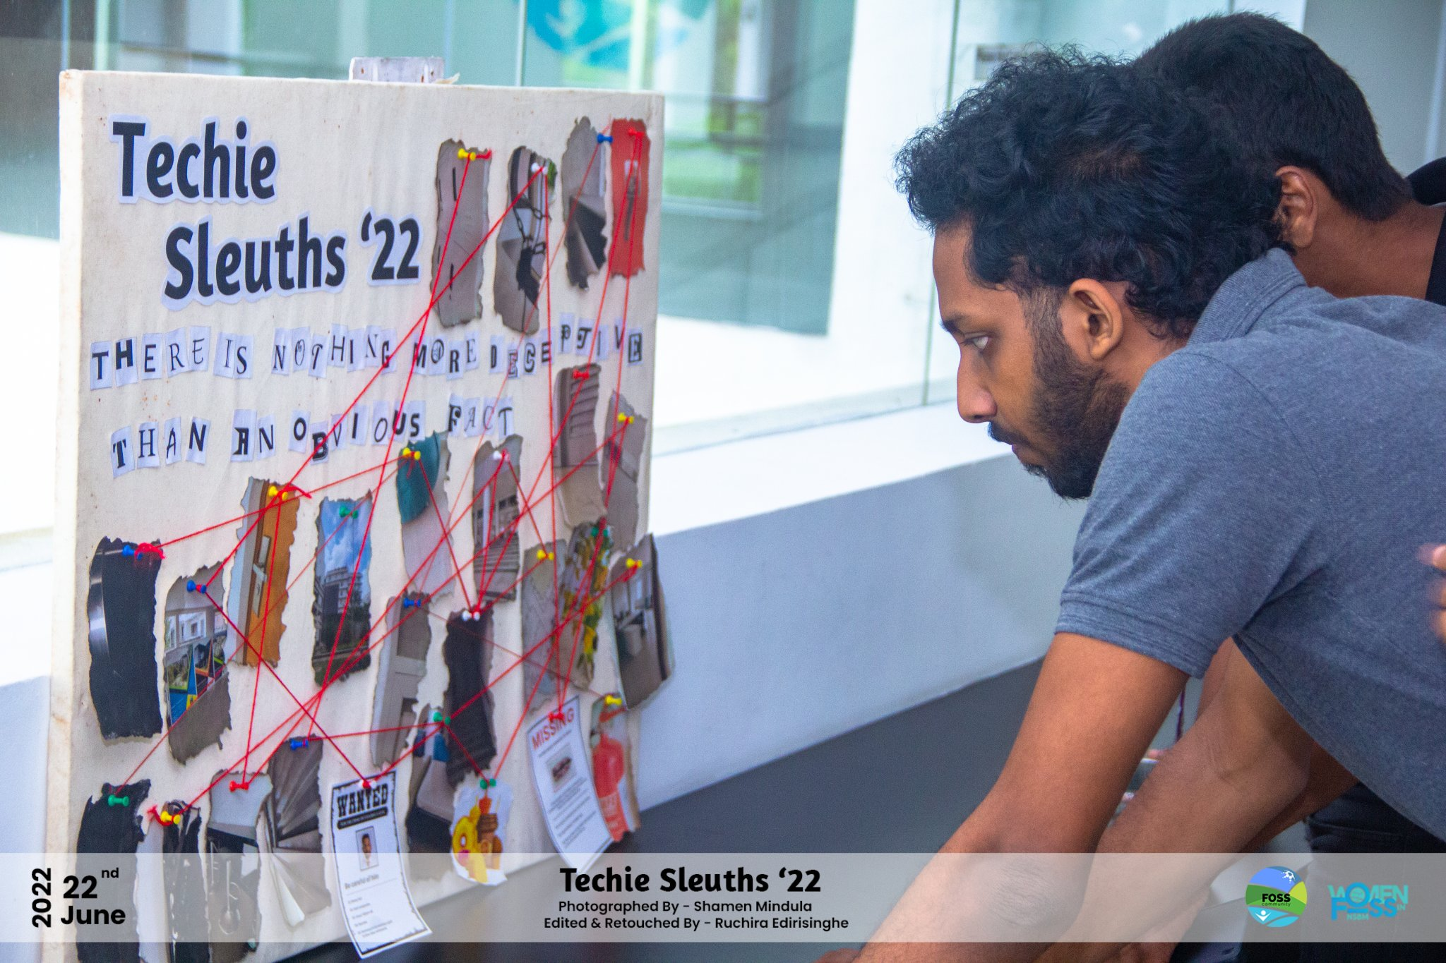
Techie Sleuths 2021, 2022
Techie Sleuths was a fun filled treasure hunt inside the Faculty of Computing that was held in order to increase technical knowledge and the interactivity of FOC undergraduates.

Slide 18
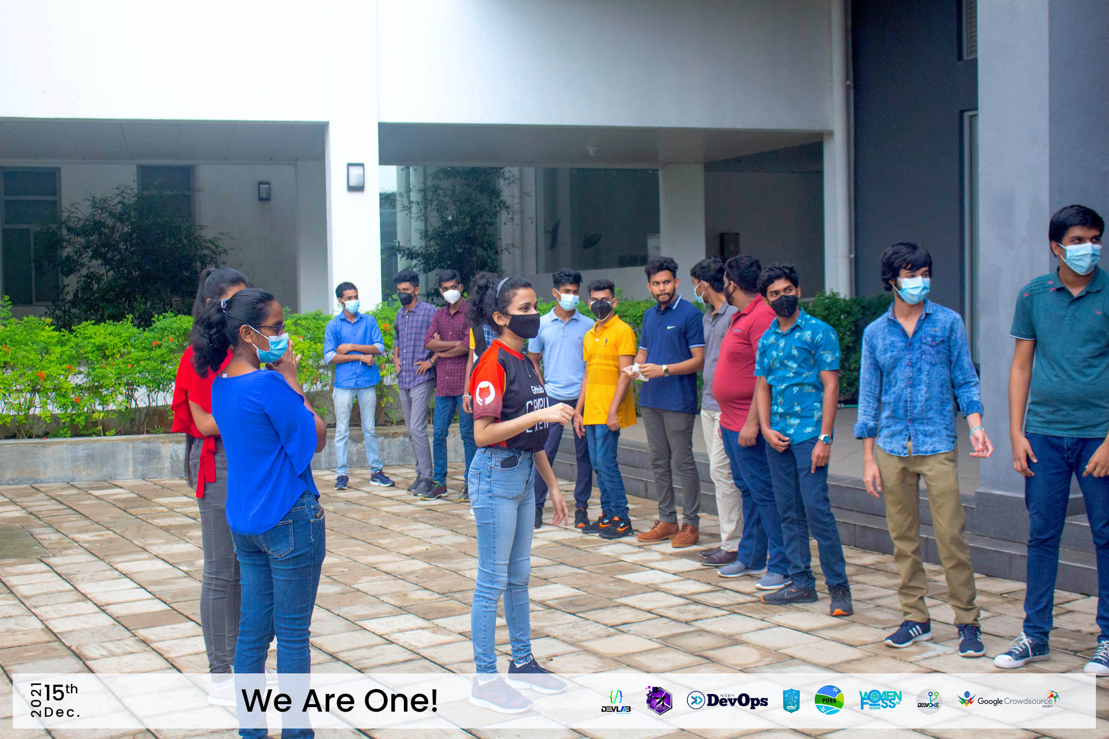
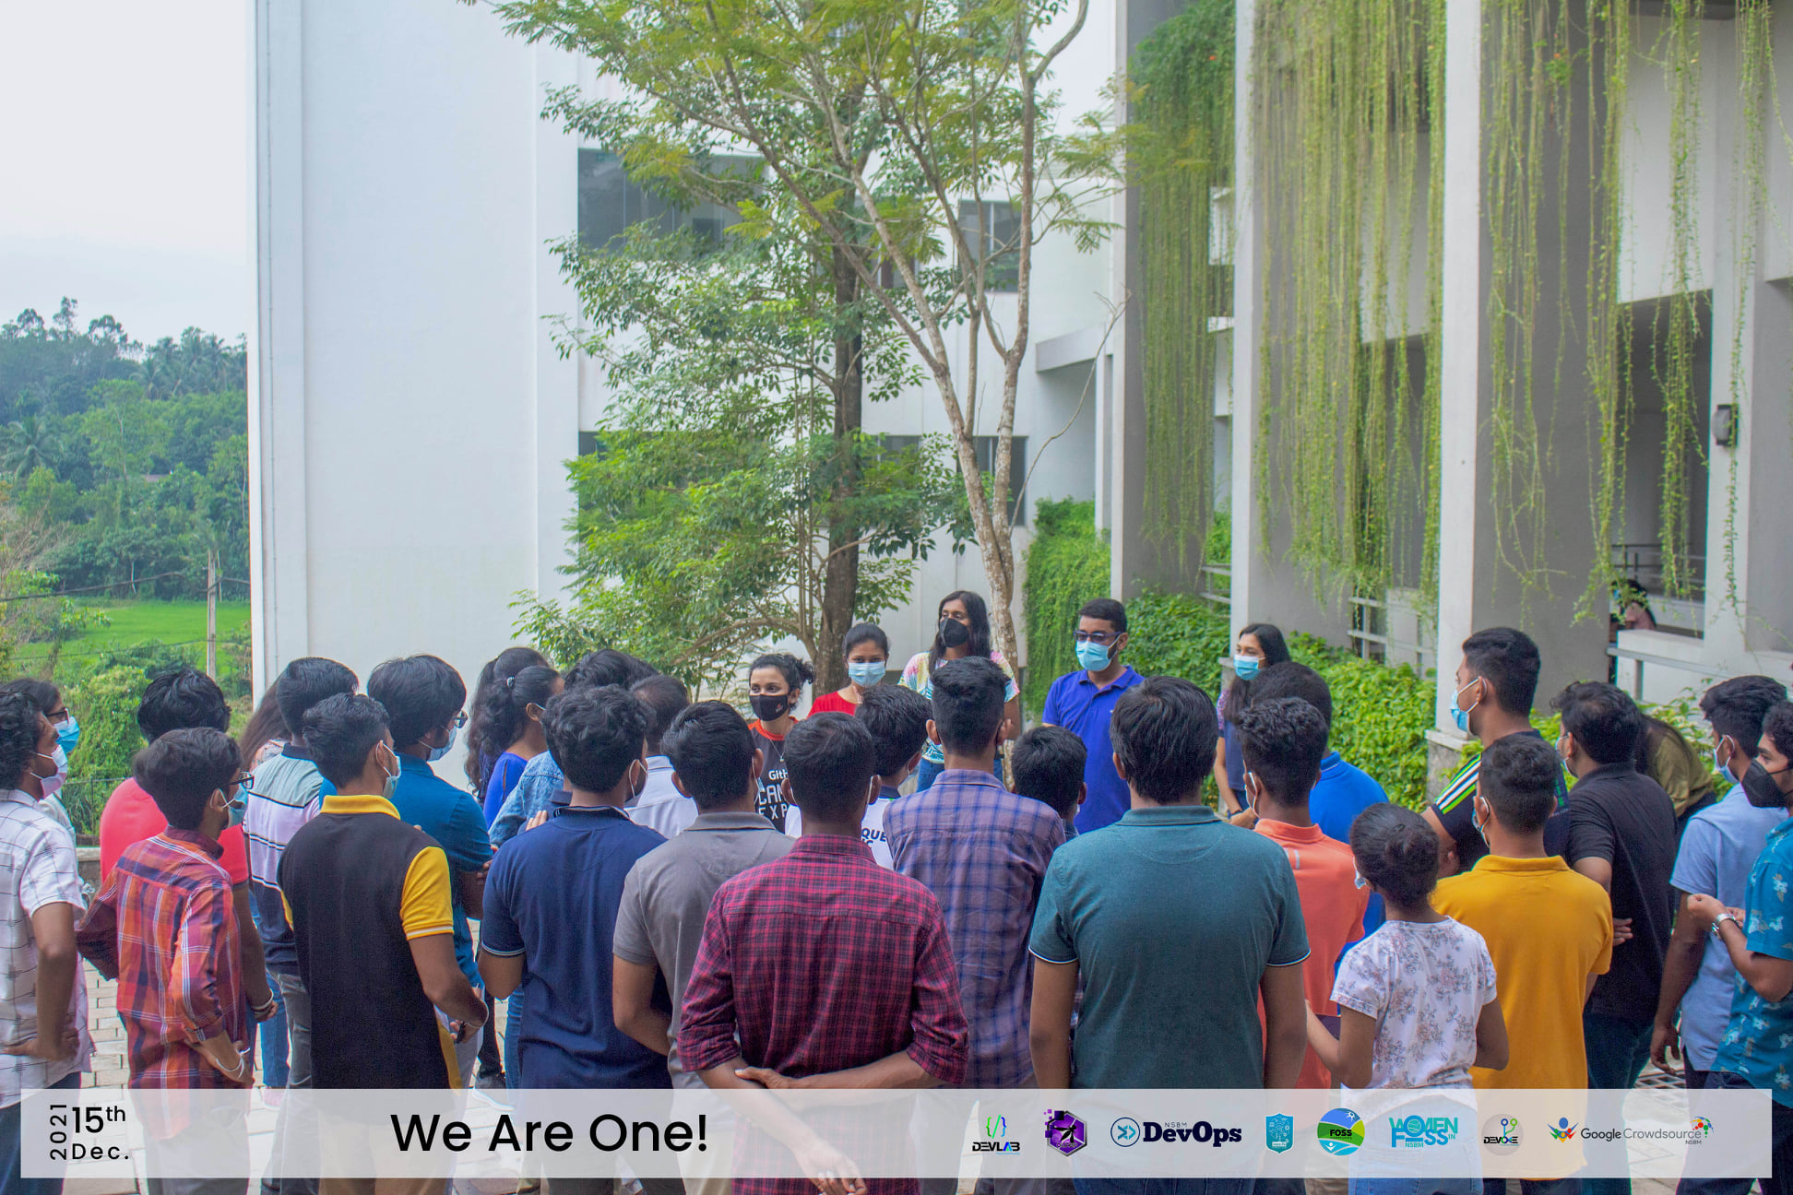
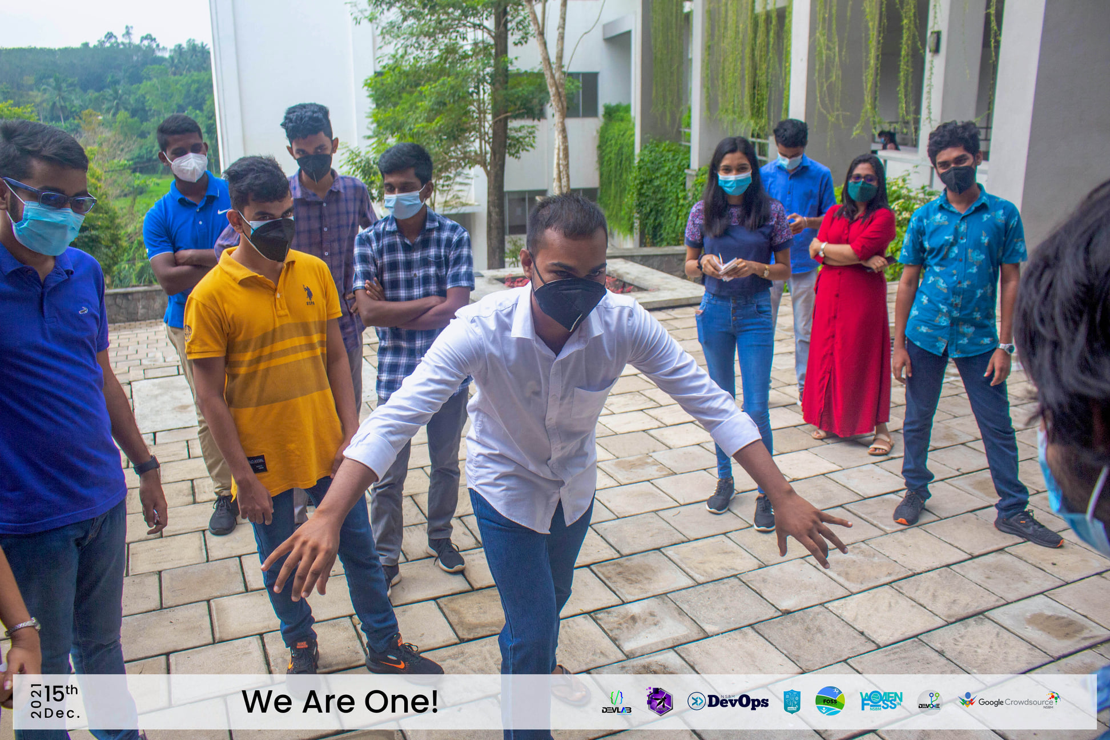
We are one
An interactive session held by the FOSS Community of NSBM, to build team spirit among its ' volunteers which was filled with fun games and singing.

Slide 19
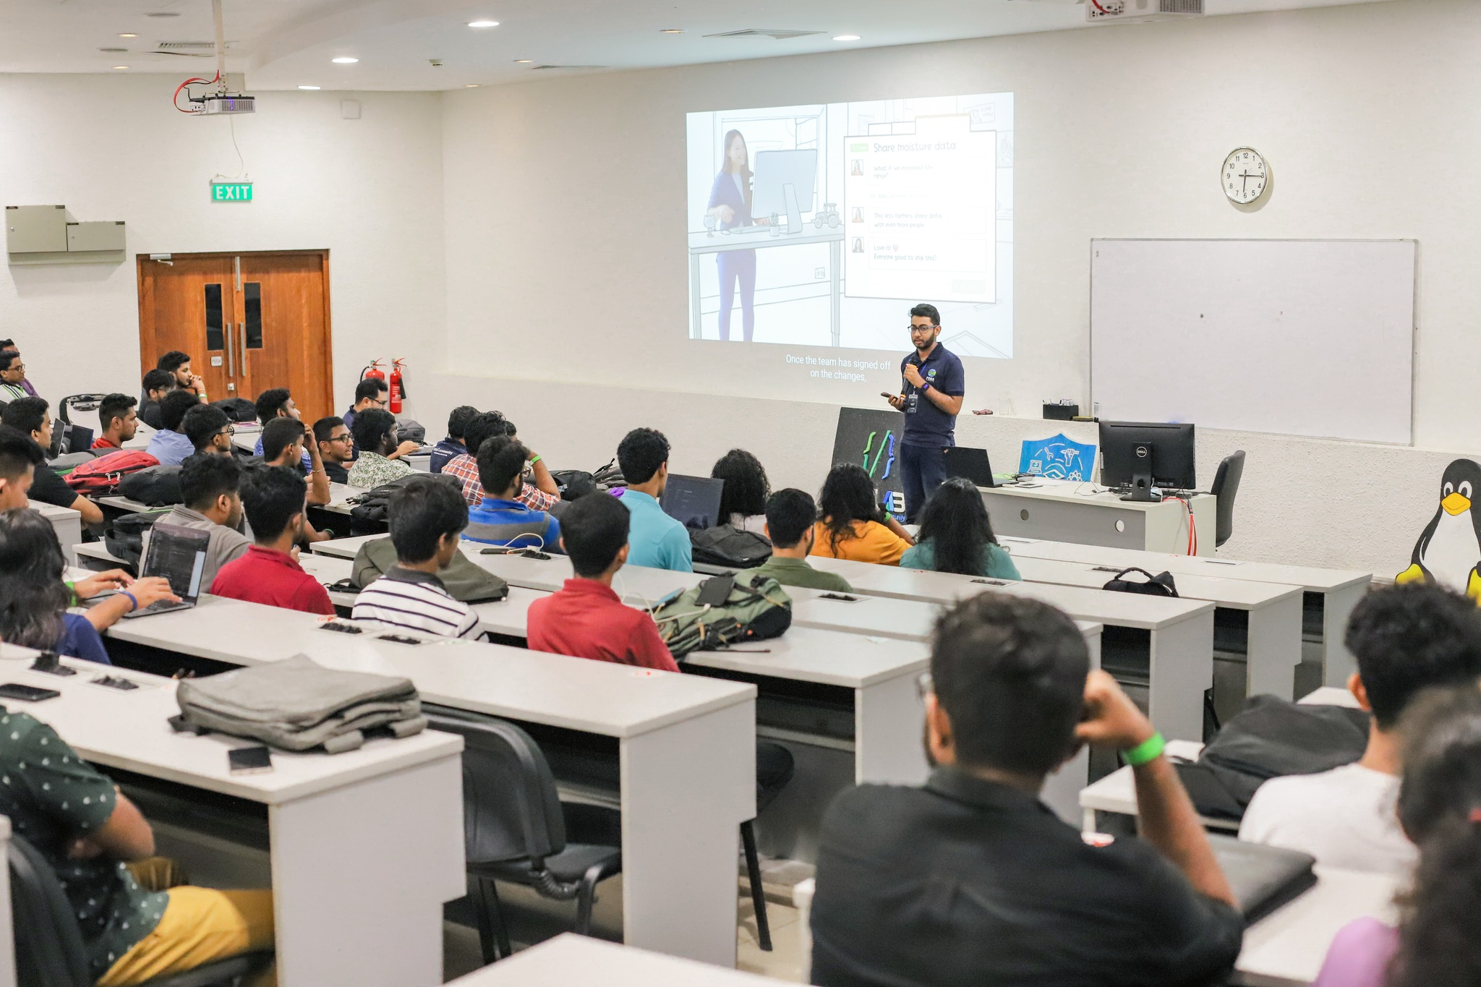
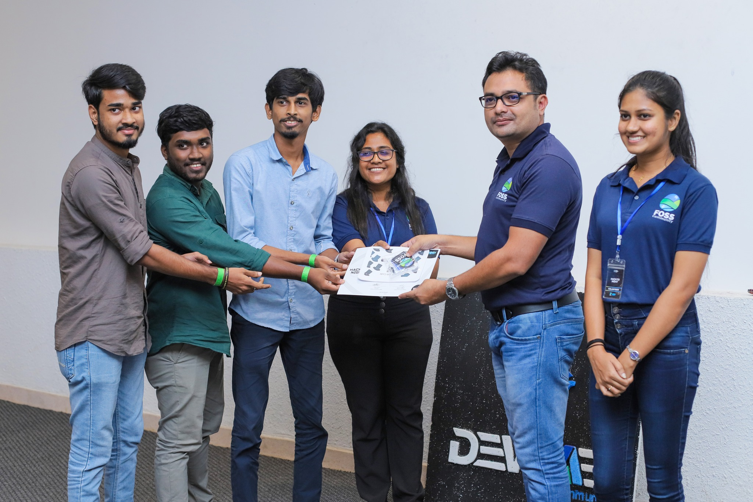
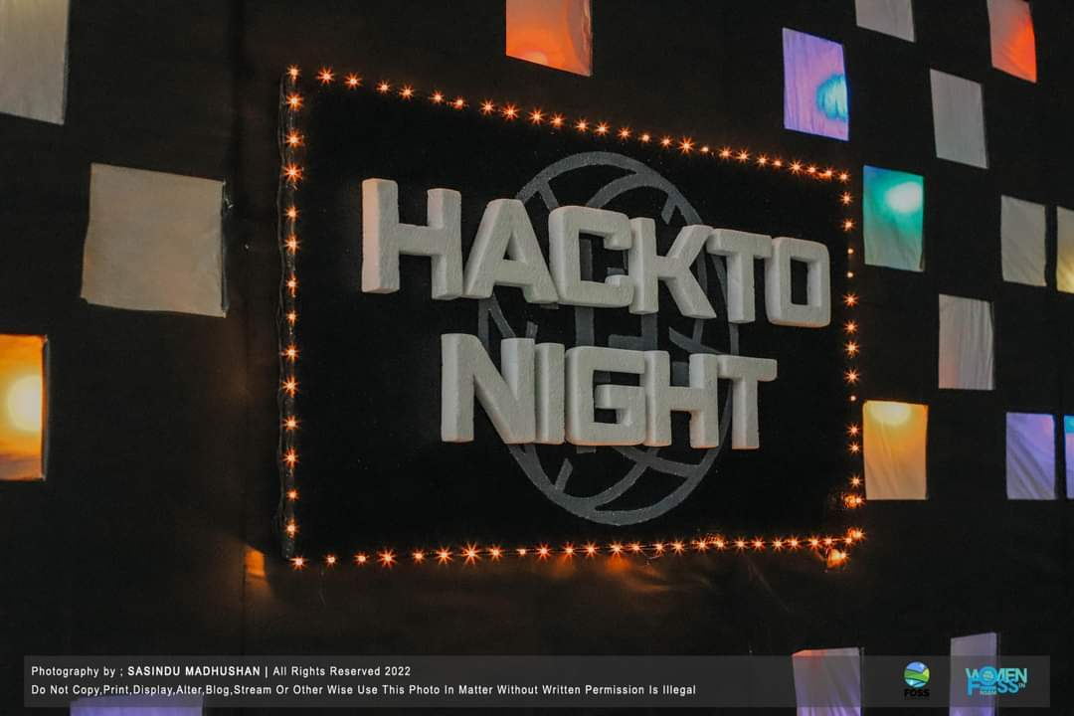
Hackto Night
HacktoNight 2022 at NSBM is an overnight competition planned by the FOSS Community of NSBM. The participants' team spirit, technological knowledge, problem-solving skills, and coding skills will be tested here. We increase the contribution of NSBM undergraduates toward open source.

Slide 20
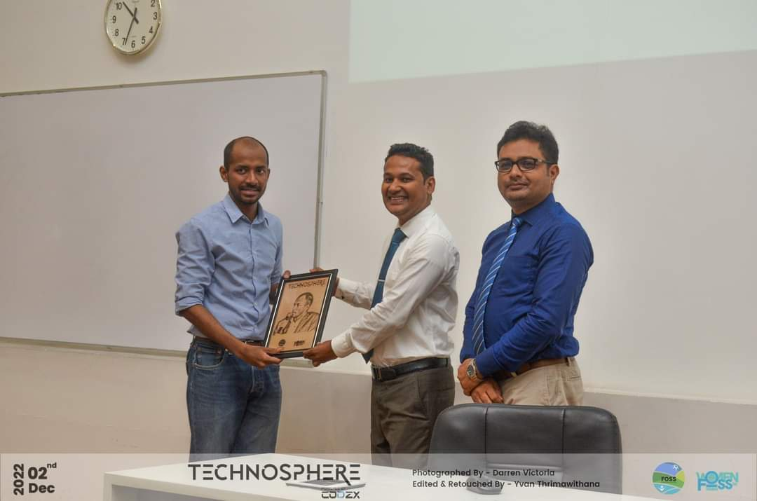
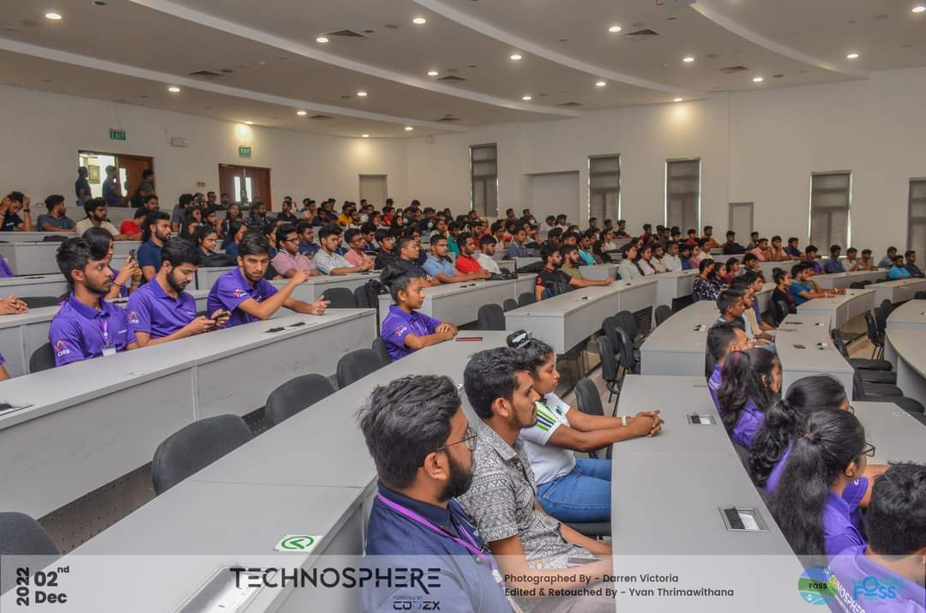
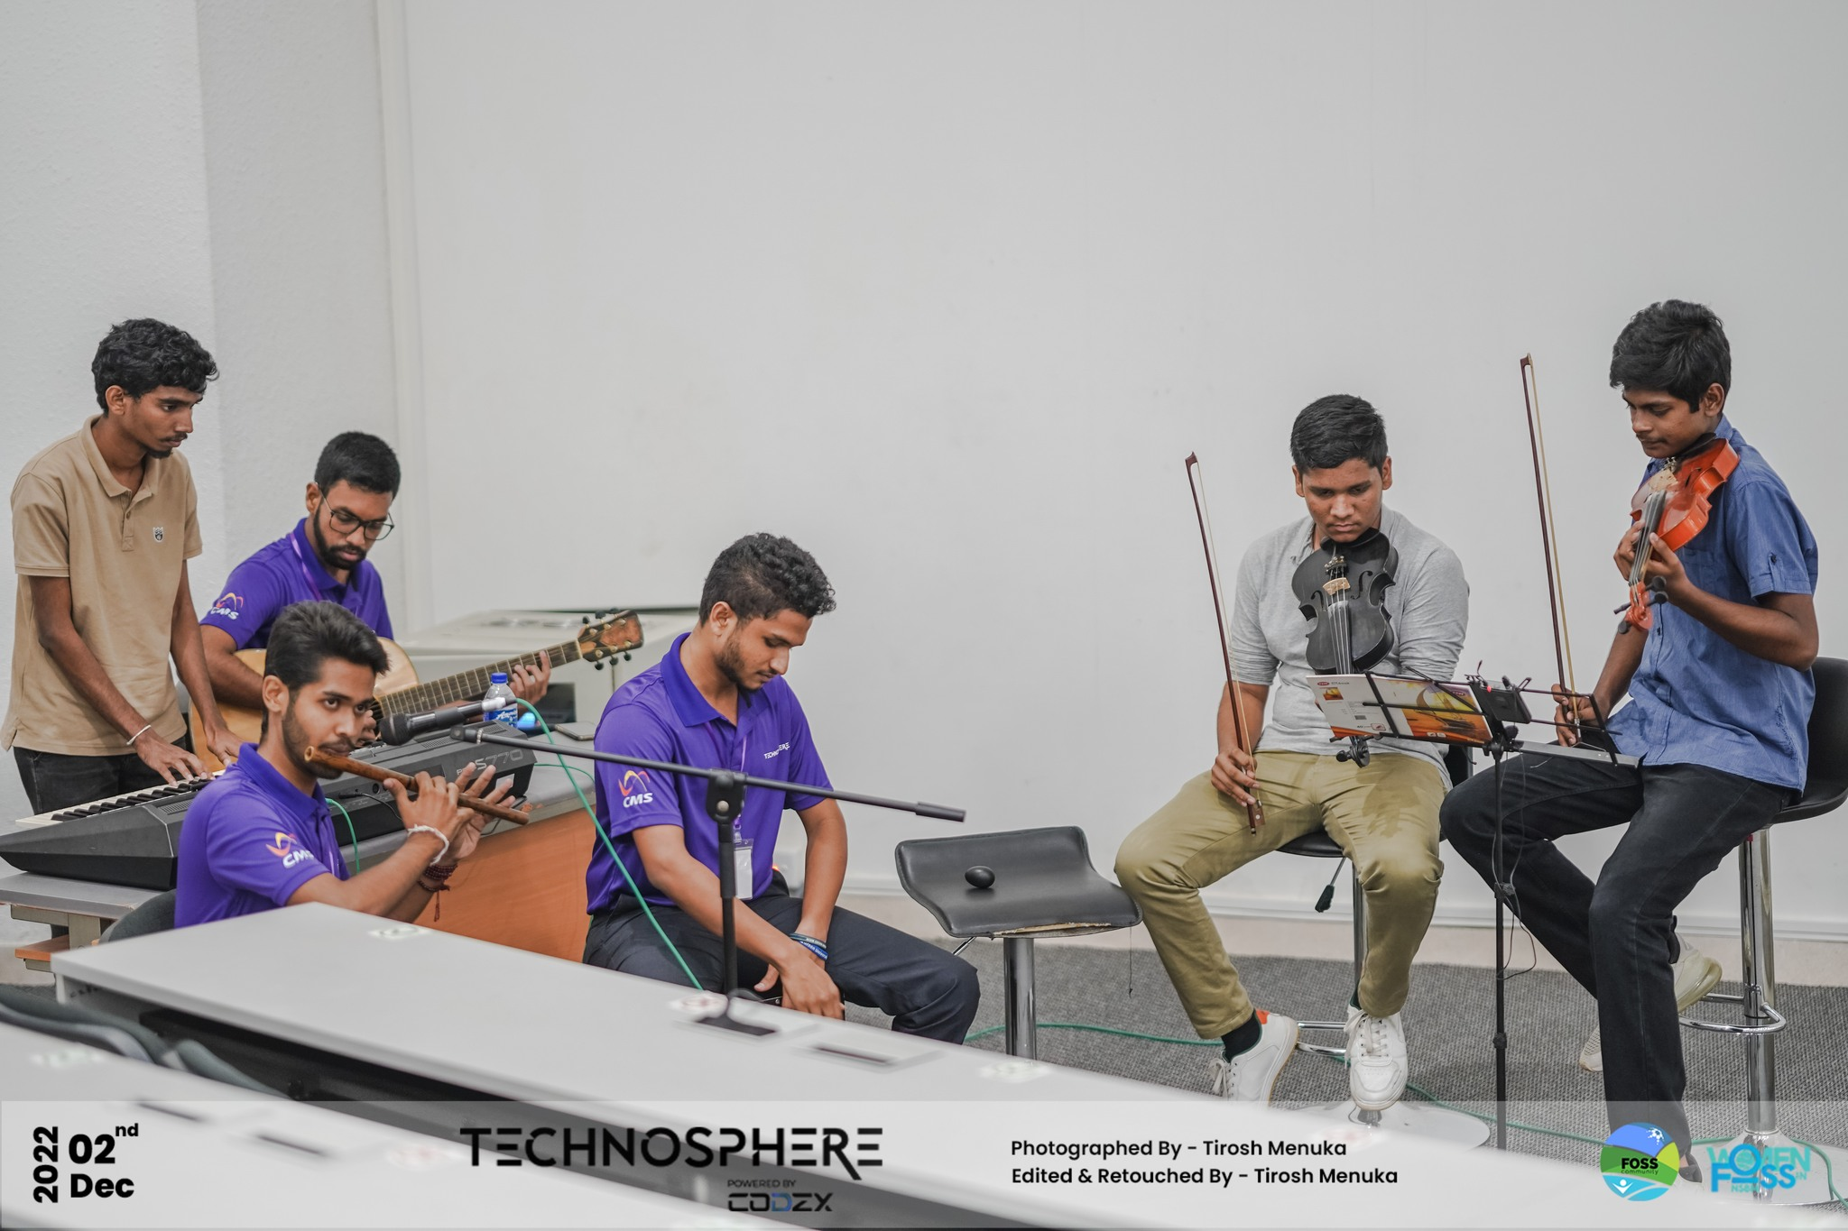
Technosphere
Technosphere 2022 is a hybrid convention organized by the FOSS Community of NSBM. This convention consisted of an online webinar series and an in-person main event. They were conducted by a number of industry experts on several future-ready technologies.

Slide 21
Thank you

